Slide 1
Personalized Fitness Scheduler using MERN Stack
Aryan Gandrath: Setup Environment, Progress Tracker
Shreya Reddy Chidirala: UI/UX Designer, Backend Developer
Rohith Arikatla: Backend Developer, Testing & QA
Pravallika Gandla: Workout Plan Feature, Progress Tracker

Slide 2
System Description, Scope, and Goal
SYSTEM DESCRIPTION
SCOPE
GOAL
Our project is a web-based workout planner built on the MERN Stack: MongoDB, Express, React, and Node.js. In today's fast-moving world, with a growing focus on fitness, this application attempts to facilitate ease in managing and maintaining workout schedules according to an individual's preference and level of fitness. Accordingly, the users would be able to create personalized workout plans, which would help them track their progress and provide feedback in detail to help them optimize their journey toward fitness.
Design an intuitive user interface to help the user in creating or managing workout plans.
Development of server-side services for user authentication, storing data in a secure manner, and retrieving.
Ensuring that performance and data security will enable seamless and safe user experiences.
Offer customized exercise programs according to an individual's fitness level and goals.
Tracking of progress and visualizations that let users track their improvement.
It aims to deliver a responsive and user-friendly experience that could facilitate consistent fitness management.

Slide 3

Main User Stories
Users should be able to create an account by signing up so that my data relating to work-outs is saved securely, and at any time, they can access it to manage my journey of keeping fit with ease.
Users should be able to create a customized workout plan with regard to my fitness level and goal so that they can work out in a structured manner according to my objectives relating to health.
They want it to be possible as a user to view in detail my workout history, including metrics and visual charts of progress, so that they can evaluate and work on aspects of my exercise routine that need improvement.

Slide 4
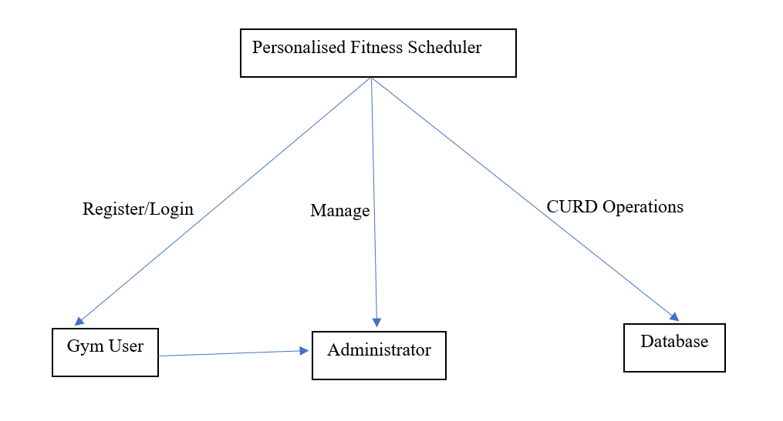
Context Diagram
The Personalized Fitness Scheduler acts as the central system, allowing gym users to interact with their workout plans, while administrators manage user data, and the database ensures efficient storage and retrieval of information.

Slide 5
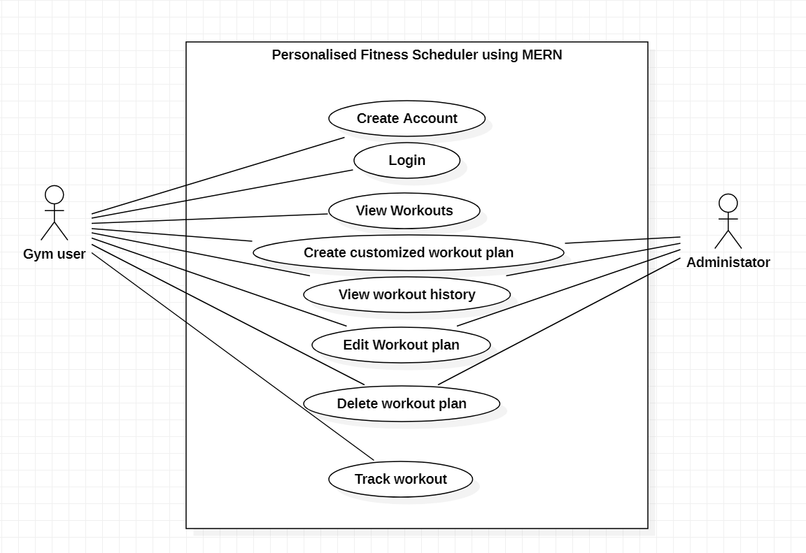
Usecase Diagram
The "Personalized Fitness Scheduler" is a MERN-based application that allows gym users to create accounts, view and customize workout plans, track workouts, and view history. Administrators can also manage and track user workout plans, providing a streamlined way for both users and administrators to manage personalized fitness goals.

Slide 6
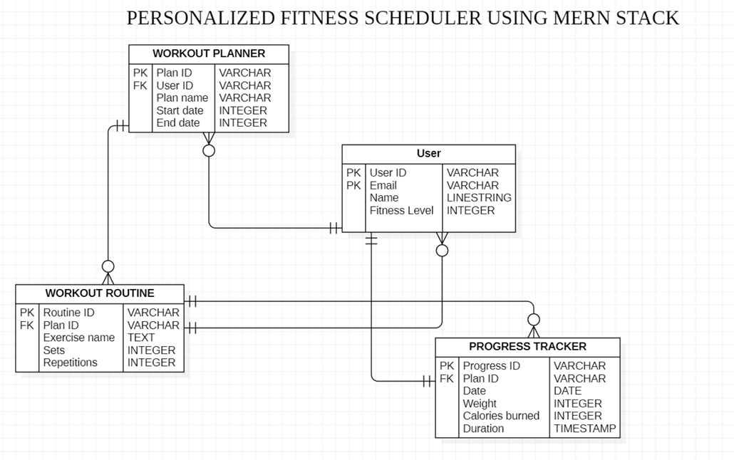
Database Diagram
The "Personalized Fitness Scheduler" database schema is structured to manage workout plans, routines, users, and progress tracking. The User table stores user details and fitness levels. The Workout Planner table connects users to specific workout plans with start and end dates. Each plan has associated exercises in the Workout Routine table, detailing sets, repetitions, and exercises. The Progress Tracker logs daily progress for each plan, including weight, calories burned, and workout duration. This schema ensures efficient tracking and customization of fitness plans for users.

Slide 7
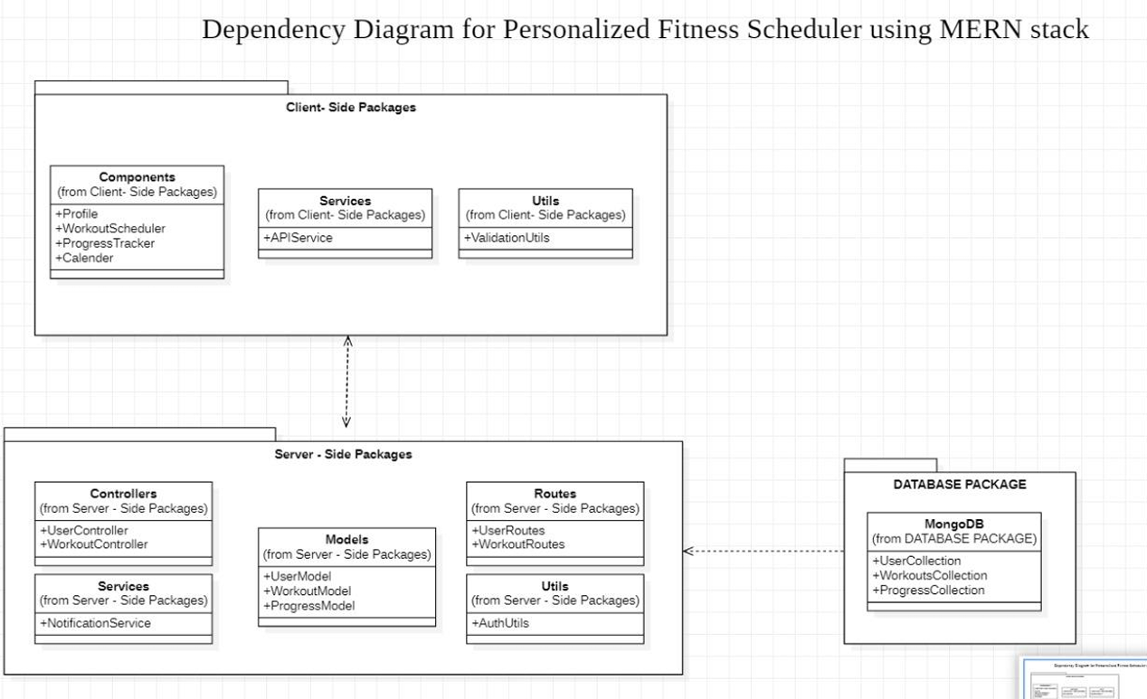
Dependency Diagram
Here is the dependency diagram of the "Personalized Fitness Scheduler" by MERN stack. All the packages are organized according to how it will structure the application. The Client-Side Packages include components in user profile, workout scheduler, progress tracker, calendar utility, and services that reach out to an API. The Server-Side Packages include controllers, models, services, routes, and utility functions which manage users, workouts, and notifications. The Database Package uses MongoDB collections for storing information about the users and their workouts; the same goes for the progress thereafter. It is a such structure that greatly facilitates the communication between the client, server, and database layers.

Slide 8
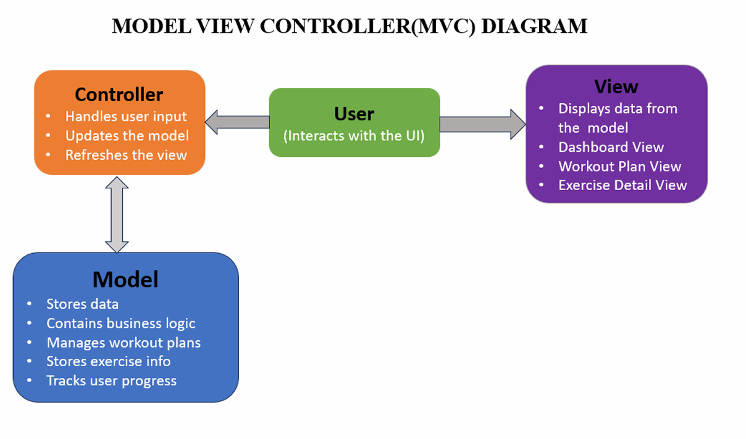
MVC Diagram
The "Personalized Fitness Scheduler" follows the MVC architecture:
Model: Manages data and logic, with models for workouts, exercises, and user progress.
View: Displays data to the user, including a dashboard, workout plan, and exercise details.
Controller: Handles user inputs, updates the model, and refreshes the view.

Slide 9
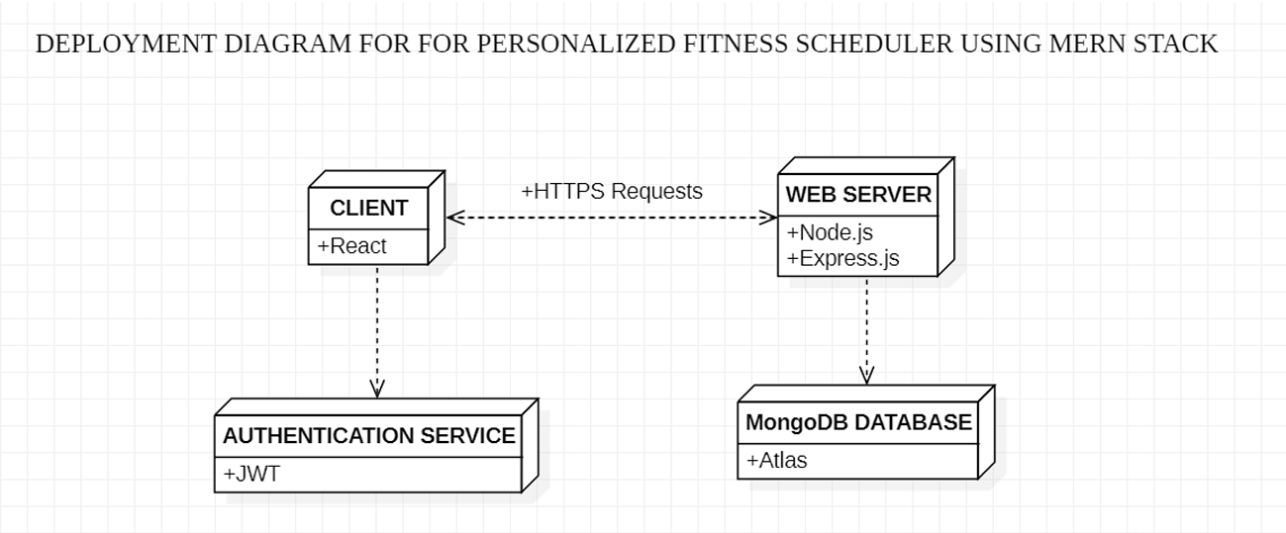
Deployment Diagram
The "Personalized Fitness Scheduler" consists of a React frontend for users to manage workouts and track progress. The backend, built with Node.js and Express.js, handles API requests, business logic, and authentication with JWT for secure sessions. MongoDB stores user data, workouts, and progress in a flexible format, with middleware for validation and error handling.

Slide 10
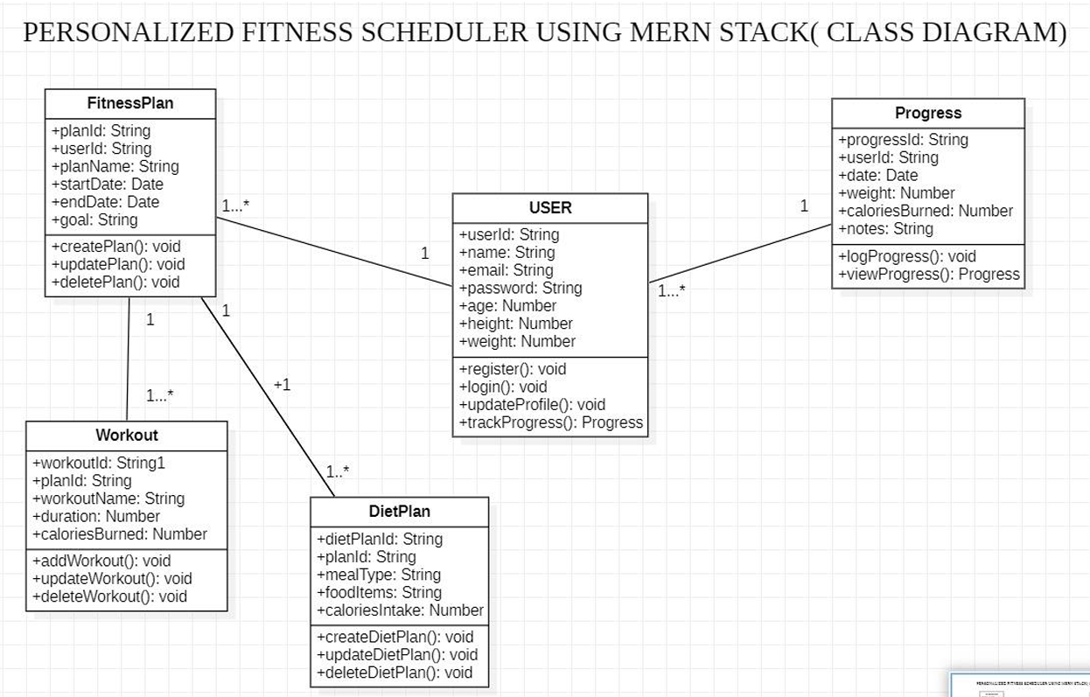
Class Diagram
The class diagram represents a personalized fitness application with five main entities: FitnessPlan, User, Workout, DietPlan, and Progress. Each entity has attributes that store relevant information, such as planId for fitness plans, userId for users, and workoutId for workouts. Each entity also includes methods to manage the data, such as creating, updating, and deleting plans, workouts, and diet plans, along with logging and viewing user progress. Together, these entities enable users to create and manage fitness plans, track workouts, monitor diet, and log progress over time.

Slide 11
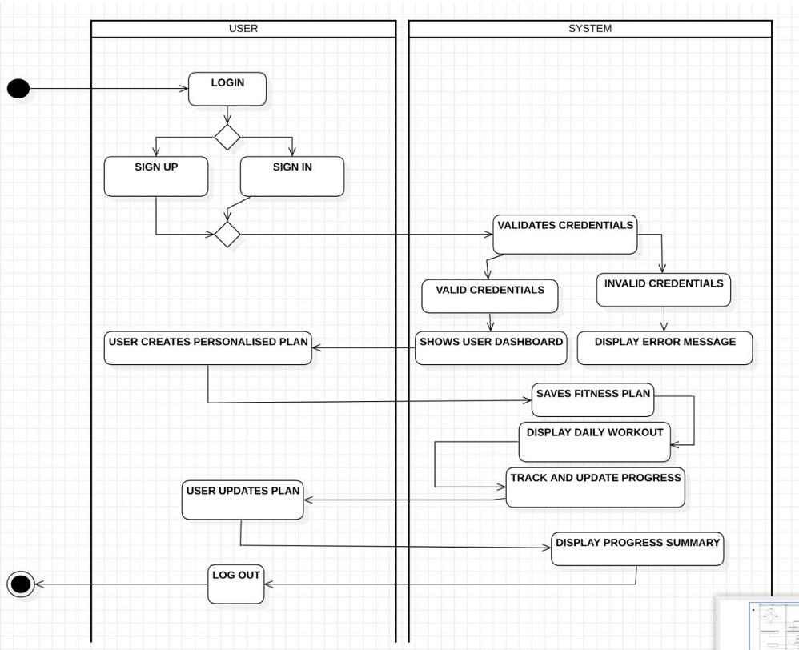
Sequence Diagram
The sequence of actions in the "Personalized Fitness Scheduler" begins with the user logging in, where they can either sign up to create a new account or sign in if they are an existing user. After the user enters their credentials, the system validates the information to ensure it’s correct. Upon successful login, the system displays the user’s main dashboard. From there, the user can create a personalized fitness plan, which the system saves in the database. The system then shows the user their daily workout routine, and as they progress, it tracks and updates their fitness data. The user can view a summary of their progress at any time. If the user wishes to make changes, they can update their fitness plan. Finally, when finished, the user can log out, exiting the application.

Slide 12
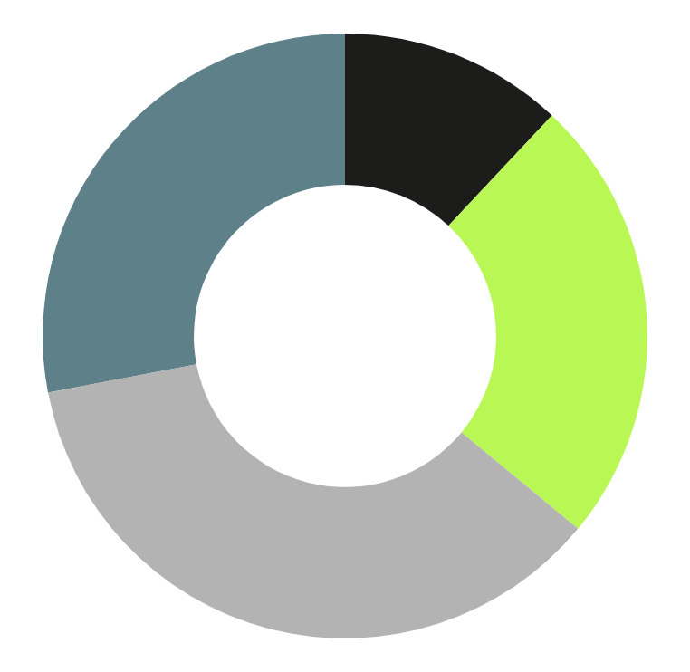
State of Development Using Product Backlog
Sprint 1
Setup Environment (Completed) UI/UX Design (Completed)
Sprint 2
Backend Development (Completed) Workout plan feature (Completed)
Sprint 3
Progress Tracker (Completed)
Sprint 4
Testing and Q&A (Completed) Deployment and Documentation (In Progress)

Slide 13
Lessons Learned
Feature Debugging
Database Connectivity
Resolving MongoDB connection issues taught us to configure databases carefully and handle authentication challenges.
Implementing the Progress Tracker emphasized the importance of breaking down tasks and systematic testing, improving our debugging skills.
Time Management
Technical Skills
Working within sprint deadlines sharpened our planning and prioritization skills, helping us stay on track.
We gained hands-on experience with the MERN stack, including user authentication, MongoDB integration, and creating interactive features.

Slide 14
Next steps
Testing: Conduct thorough testing to identify and resolve any issues.
Final Deployment: Prepare for production deployment and complete documentation.
Presentation Preparation: Create a detailed project demo and presentation for final submission.

Slide 15
Github Link
https://github.com/shreyareddych/Group_10-RASP-

Slide 16
Thank You

